Slide 1
VIRTUAL MOUSE USING HAND GESTURES
Guided By-
Prof. Dinesh Naik
222IT007- Tushar Satish Chaudhari
222IT031- Shubhranshu Dubey

Slide 2
PROBLEM STATEMENT
Build a framework to control the mouse cursor using Google’s mediapipe to help users navigate through the operating system along with some keyboard functions.

Slide 3
MODULES USED
MEDIAPIPE
"MediaPipe offers cross-platform, customizable ML solutions for live and streaming media.".
12
8
16
11
7
15
10
20
6
14
19
4
5
9
13
18
PyAutoGUI
“PyAutoGUI lets your Python scripts control the mouse and keyboard to automate interactions with other applications.”
3
17
2
1
0

Slide 4
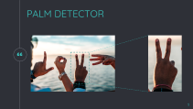
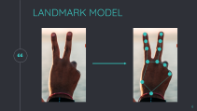
MEDIAPIPE
PALM DETECTOR
LANDMARK MODEL
Takes image frame as input.
Detects palm(s) in a frame along with handedness.
Outputs the cropped image of the detected palm.
Takes palm detector’s output as input.
Processes the image and gives for landmark skeleton.
Provides landmark points as output vector.

Slide 5

PALM DETECTOR

Slide 6
LANDMARK MODEL

Slide 7
MEDIA PIPE FRAMEORK
Image Frame
Cropped Palm
Region
Web Camera Feed
Palm Detection
Landmark Model
Landmark Points
42 Normalised Points
Save Trained Model
Prediction Model Training
Data Normalisation
Class Label

Slide 8

MULTI-CLASS CLASSIFICATION MODEL
We have designed a multiclass classification model which takes the normalized point values along with the class label.
This model is than saved for real time gesture prediction.
According to the model’s output, we then perform actions using PyAutoGUI.

Slide 9
1
G1
1
G2
2
1
G3
3
2
G4
4
3
2
G5
5
4
3
G6
G7
41
19
10
G8
42
20
G9
Hidden Layer 2
43
Hidden Layer 1
G10
Input Layer
Output Layer

Slide 10
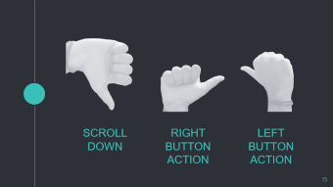
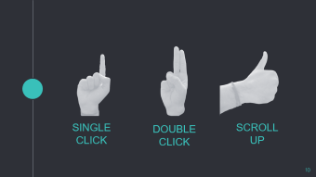
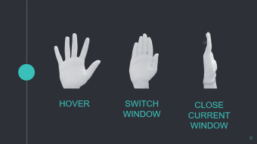



GESTURES

Slide 11
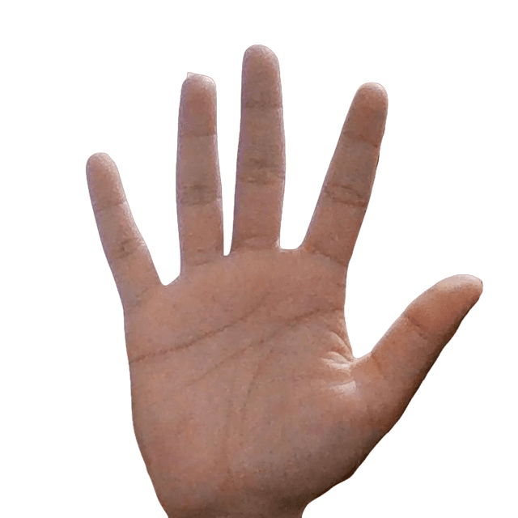
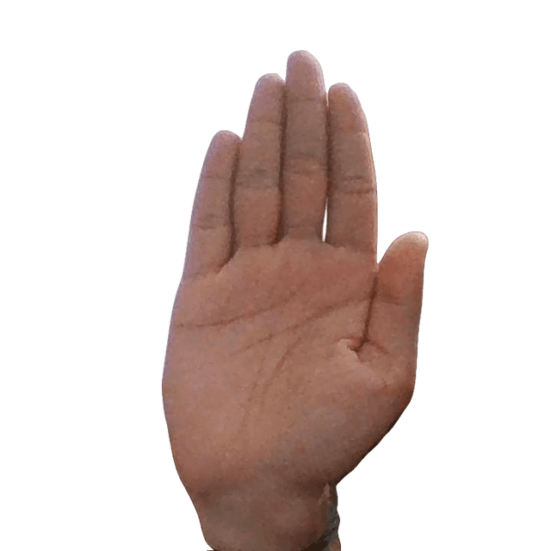
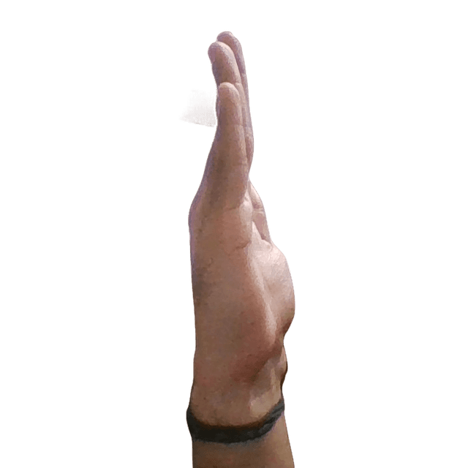
HOVER
SWITCH
WINDOW
CLOSE CURRENT
WINDOW

Slide 12
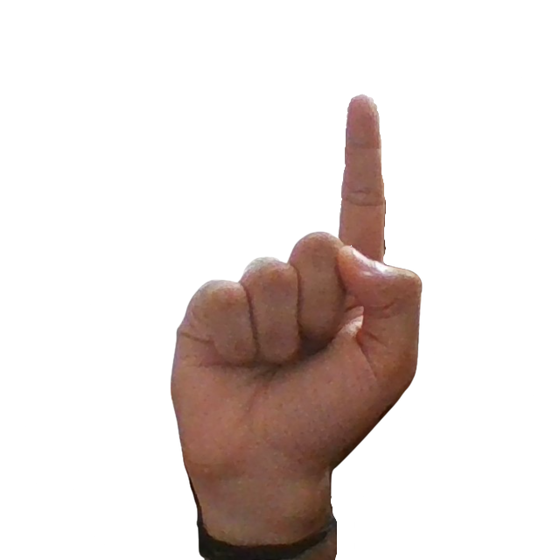
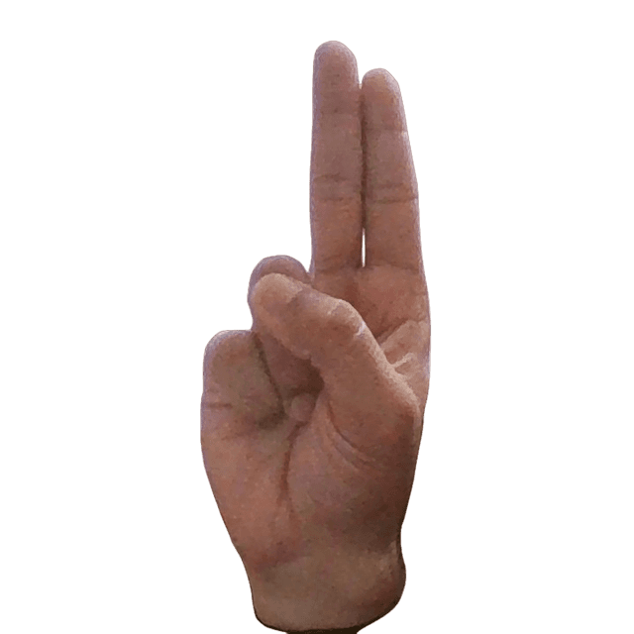
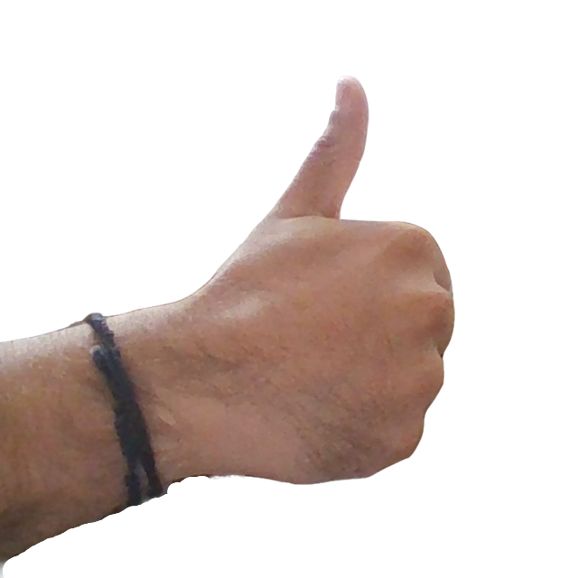
SINGLE CLICK
DOUBLE CLICK
SCROLL
UP

Slide 13
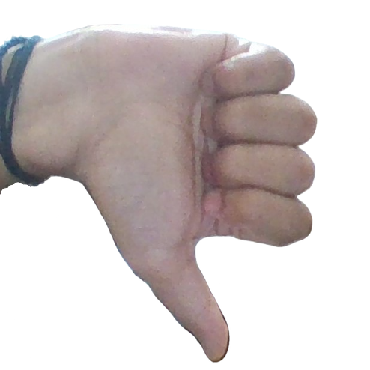
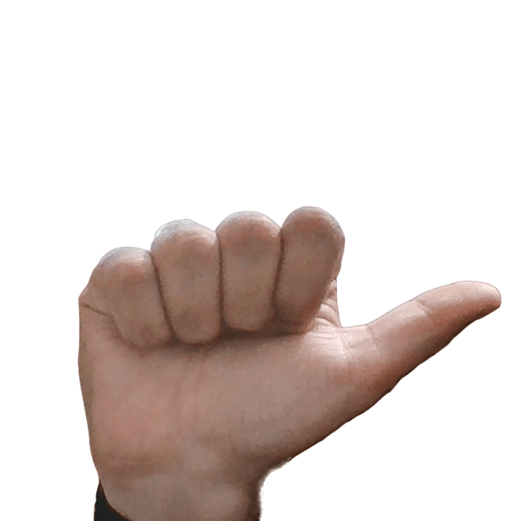
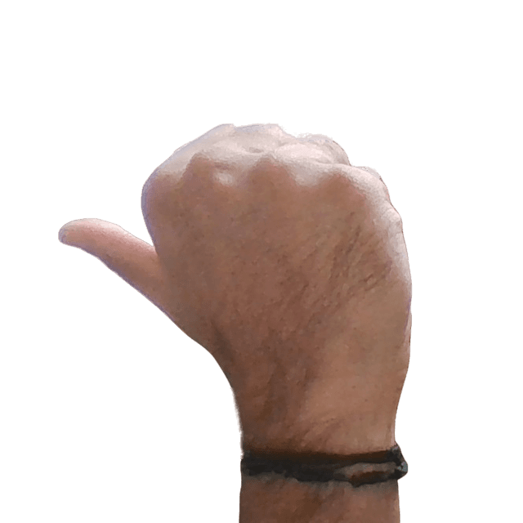
SCROLL DOWN
RIGHT BUTTON ACTION
LEFT BUTTON ACTION

Slide 14
REFERENCES
https://www.researchgate.net/publication/326780110_Ha nd_Gesture_Recognition_Using_Convolutional_Neural_ Networks_and_Depth_Camera
https://openaccess.thecvf.com/content_cvpr_2018_works hops/papers/w37/Mencattini_RealTime_Hand_Gesture_CVPR_2018_paper.pdf
Study and Verification on the Latch-Up Path Between I/O pMOS and N-Type Decoupling Capacitors in 0.18--m CMOS Technology | IEEE Journals & Magazine | IEEE Xplore
https://openaccess.thecvf.com/content_ICCV_2019/paper

Slide 15
THANK YOU

